Slide 1
Clifford & Co. E-Commerce Strategy
Customer Analytics

Slide 2



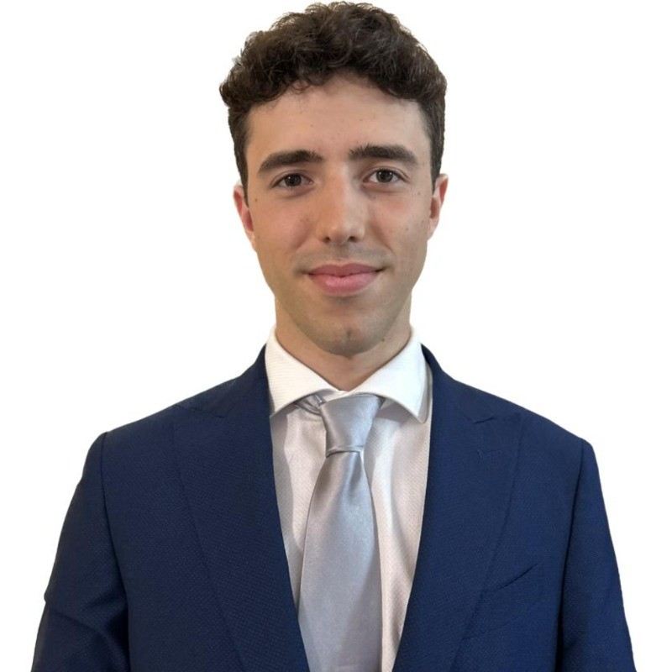

Consultant Team
Tirth Raval
Rohan Patel
Dario Vignoni
Vincent Pieries
Narendran Valliappan

Slide 3
Table of Contents
01
02
03
04
05
06
Background & Objective
Problem Identification
Analysis Overview
07
Modelling Customers
Customer Segments
Recommended Strategies
Projected Impact

Slide 4
01
Background & Objectives

Slide 5
Background & Objectives
Clifford & Co. has transitioned to an e-commerce platform in the last year and is looking to leverage data analytics on its user data to improve online revenue and streamline costs
Objectives:
Gain insights into customer behaviours using user data
Devise a plan to improve customer experience
Convert more online shoppers into successful buyers
Improve online revenue and streamline costs

Slide 6
02
Problem Identification

Slide 7

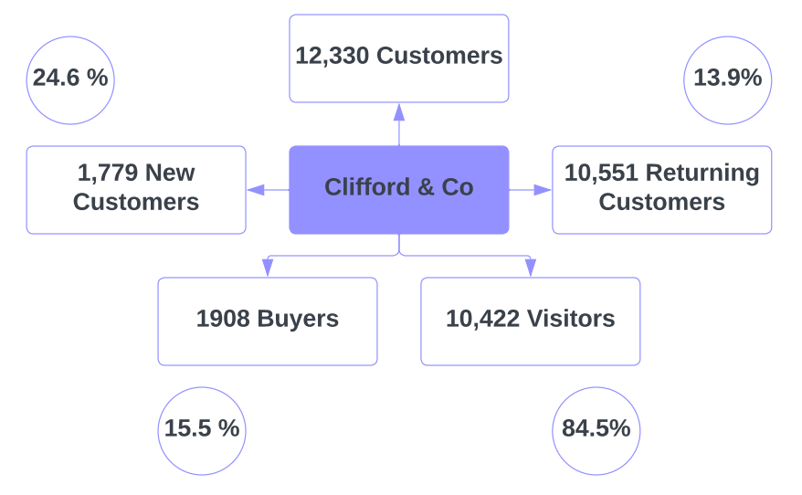
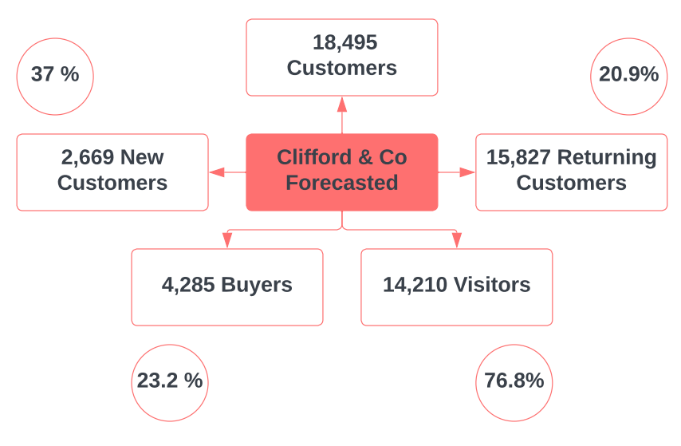
Problem Identification
Forecasted Outcome

Slide 8
03
Analysis Overview
Charateristics of your customer base

Slide 9
Factors ANALYSED
Informational Pages Engagement
Administrative Pages Engagement
Weekends
Bounce rates
Exit Rates
Transaction
Special Day
Visitor Type
Page Values
Product Related Pages Engagement

Slide 10

General Insights
Highly Influential Factors:
Page Values
Product Related Interaction
Exit Rates & Bounce Rates
Yes
Factors with Moderate Influence:
Information Pages Interaction
Administrative Pages Interaction
Visitor Type
No
Not Influential Factors:
Special Days
Weekends

Slide 11
04
Modelling Customers
Notes:
Thank you Dario – I would now like to introduce you how we modelled your customers and plan to predict the future customers

Slide 12
Data Analysis Process
Data Cleaning
Data Modelling
Machine Learning
Remove missing values and reformat to usable form (String to Binary)
Develop Models to help predict future datapoints
Develop machine learning models for future insights
02
04
06
01
03
05
Data Collection
Variable Analysis
Categorical Analysis
Collect Data and metrics from website
Review 2 variables at a time to find correlations
Split data into clusters or groups to further determine category behaviours
Notes:
To aid in modelling your customers we want to first introduce you to the Data Analysis Process. The 1st Process is the collect data and metrics from the website and its users – which you have so kindly provided. The next step is to clean the data which is basically preparing the data to make it usable to analyze. Once the data is cleaned we will move to variable analysis where we compare 2 variables at a time to determine correlations and from there we will start developing data models to trying and develop a model that can accurately predict future customer behaviours. Once the model has been developed we can split into categorical analysis to see how the behaviours can further be summarized. The final step is to develop machine learning models to help develop future insights for new customer data.

Slide 13

Machine learning modelling
LogR
Best Threshold
LogR
Full Scale
Reduced
Business
Threshold
KNN
Best Threshold
KNN
Best Threshold
Decision Tree
DT
Notes:
●To develop the machine learning model we initially started with selecting the relevant models such as Logisitc Regression, K nearest neighbour and Decision tree Analysis. From there we run the models using all the data variables, and then from determining the important variables we reduce the data and re-run the model. Once we have our reduced models we then apply the best threshold to accurately separate the data however due to the low threshold values to apply a business threshold that balances the approach to accurately predicting customers.

Slide 14
BUSINESS THRESHOLD DECISION TREE MODEL
7 Variables Used to Predict
Accuracy
1) Page Values 2) Exit Rates
3) Product Related Duration
4) Visitor Type Status
5) Produce Related Visits
6) Special Day Visits
7) Information Visits
88.4%
No Transactions
Yes Transactions
Very High Precision, Recall, and F1-Score
Balanced Precision, Recall, and F1-Score
Notes:
For our chosen model the business threshold decision tree model we utilize 7 variables or levels in this case to develop the model. With these variables we produce a model that is able to predict customers 88.4% of the time, therefore 88 out of 100 customers can be accurately predict their transaction behaviour. For No Transaction customers we were able to predict with very high accuracy vs the Customers that did complete transactions which we have a balanced model accuracy. We recommend to retrain this model semi-annually to continuously update and improve our accuracy.

Slide 15
05
Customer Segmentation

Slide 16



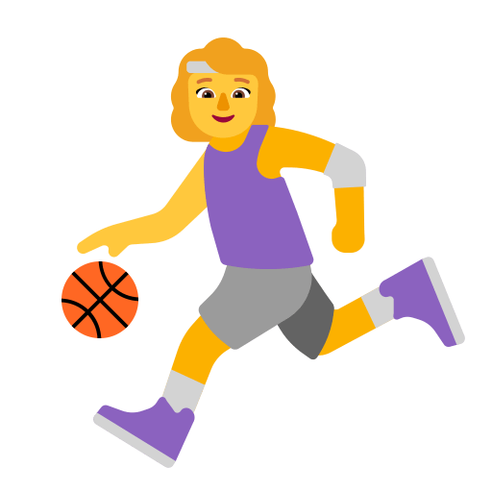
Classification Process
Segment - 1
Segment - 2
Large Customer Data
K - Means
Segment - 3
Segment - 4
Notes:
In customer segmentation process, we want to group customers with similar behaviour in to one segment. So, we can target similar customer through marketing strategy and. We trained a segmentation model to group your customers in to 4 groups. Now, this model can put customer in one of these groups based on its similarity. Now, let’s look at 4 customer segments which have been.

Slide 17
Identified segments
1
2
3
4
Loyal Shoppers
Confused Shoppers
Deal
Seekers
Bouncers
Value:
Engagement:
Loyalty:
Value:
Engagement:
Loyalty:
Value:
Engagement:
Loyalty:
Value:
Engagement:
Loyalty: -

Slide 18
Segmentation Insights

Slide 19
Implementation Process Overview
Confused Customers
Bouncers
Web Traffic
Predictive Engine
Customer Segmentation
Deal Seekers
Loyal Customers

Slide 20
06
Recommended Strategies
Promotional Strategies
Customer Development Strategies

Slide 21


Promotional Strategies
Cliff Points: Loyalty Program
Targeted Promotion
Clifford’s account = eligible to earn CPs
Integrated in the Website account
1 CP for every $1 spent
100 CP = $1 discount
For specific segments
Non transacting visitors can be targeted
Sample Promotions:
Get 500 CP when you spend over $50
$10 off over $100
Beneficiaries:
All segments
Beneficiaries:
Mainly Deal Seekers & Confused Shoppers
Benefits:
Customer Loyalty
Conversion Rate
Revenue
Benefits:
Conversion Rate
Revenue
Customer Loyalty

Slide 22
Customer Development Strategies
Website Redesign & Reliability
Reminder Initiative
Customer survey to clarify pain points
Streamline admin & informational pages
Incentivize Customer Reviews
Review warrenty & return policies
Integrated reminder program
Works in harmony with targeted promotions
Sample Reminders:
Item left in the cart
Coupon expiring
Upcoming sale
Beneficiaries:
All segments
Valuable for Confused Shoppers
Beneficiaries:
All segments
Benefits:
Customer engagement
Conversion Rate
Revenue
Benefits:
Customer experience
Customer Engagement

Slide 23
Thank You!
Any Questions

Slide 24
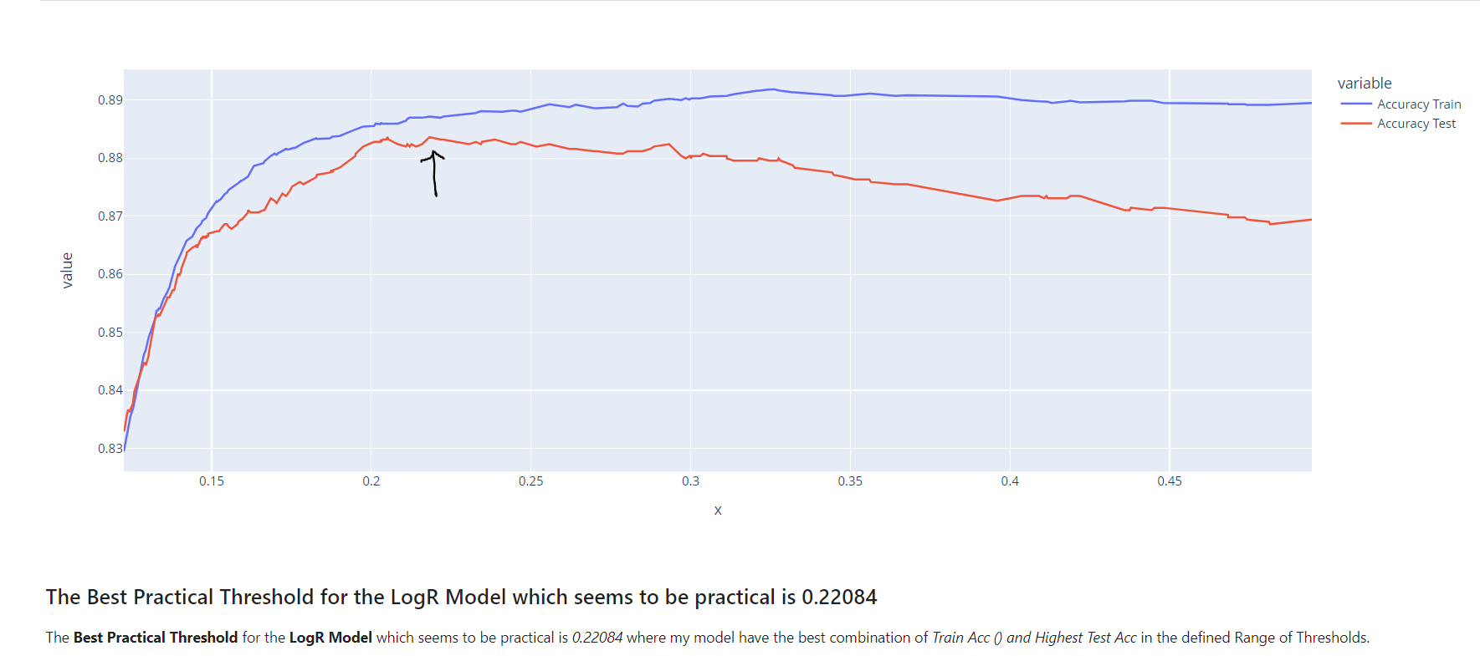
Appendix

Slide 25
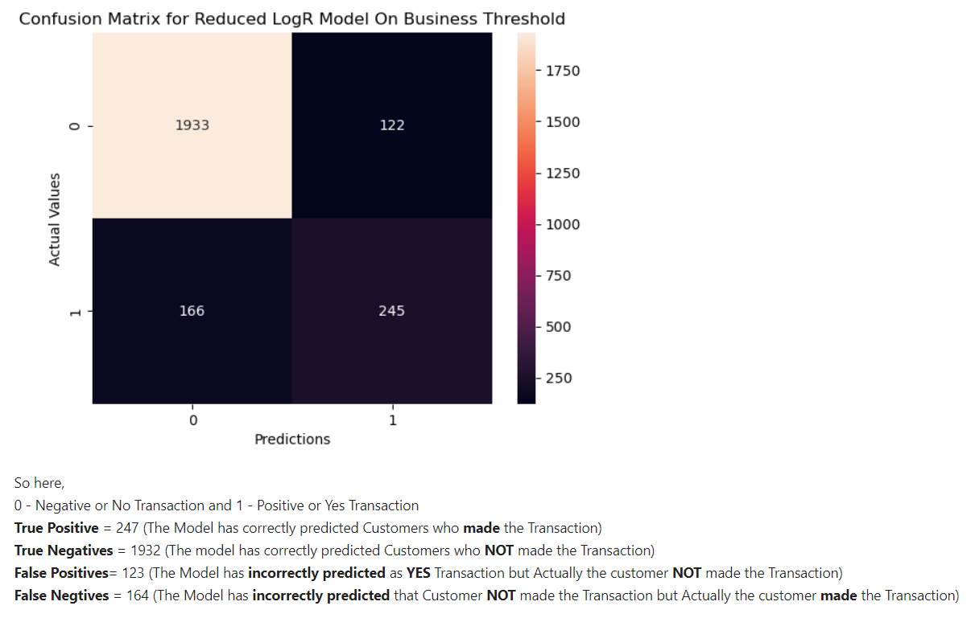
Appendix

Slide 26
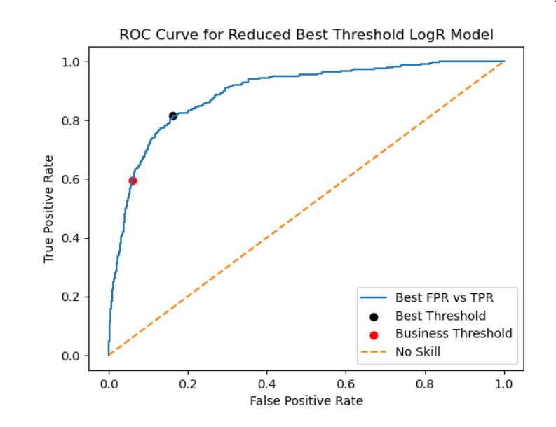
Appendix

Slide 27
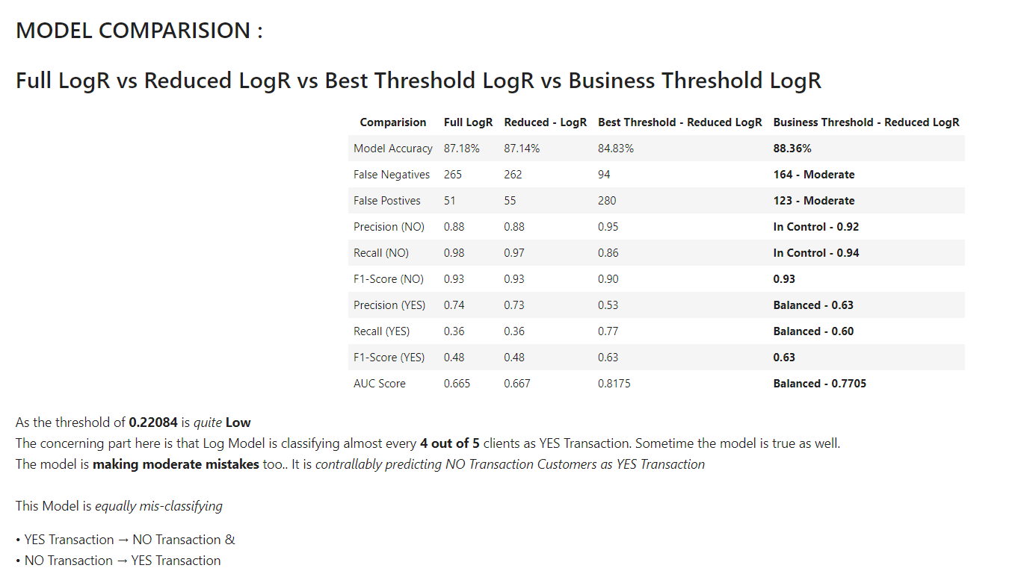
Appendix

Slide 28
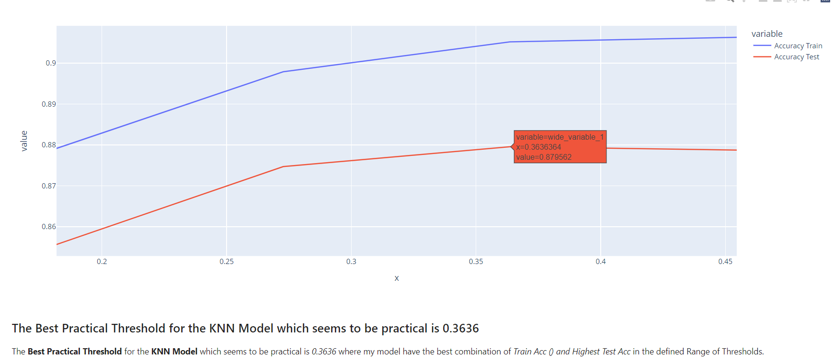
Appendix

Slide 29
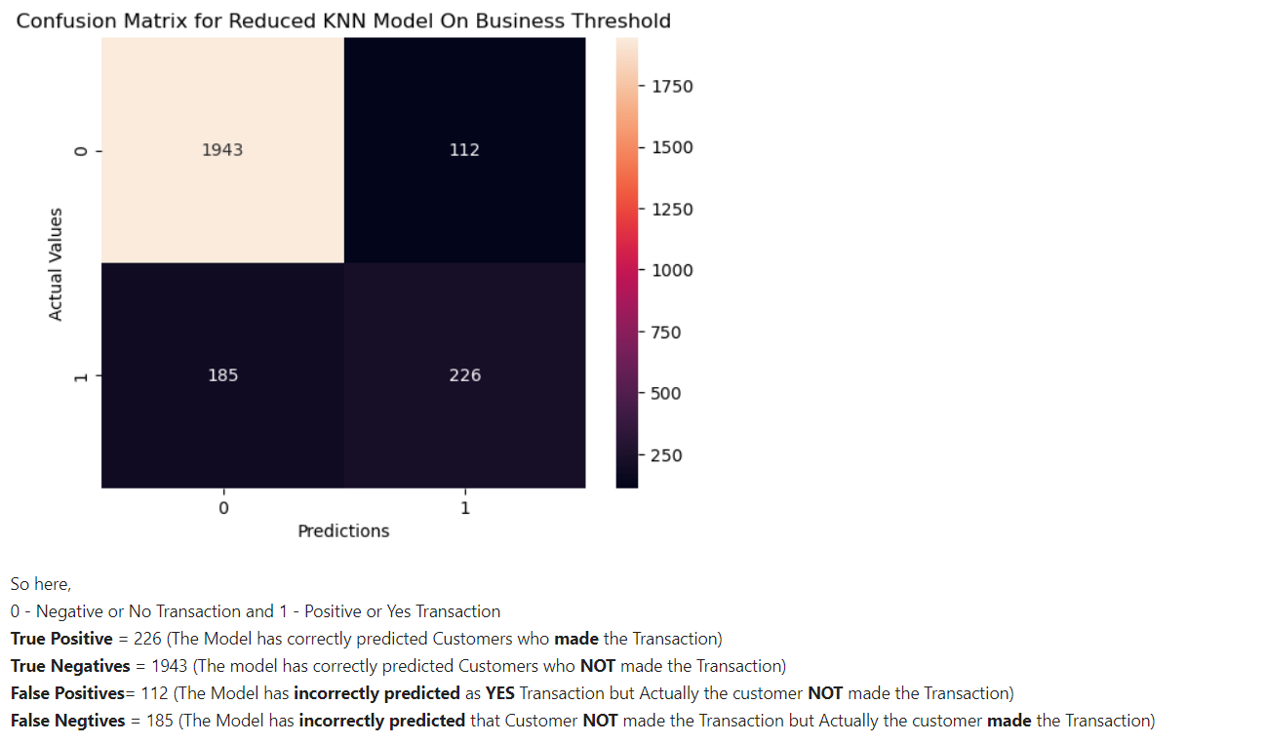
Appendix

Slide 30
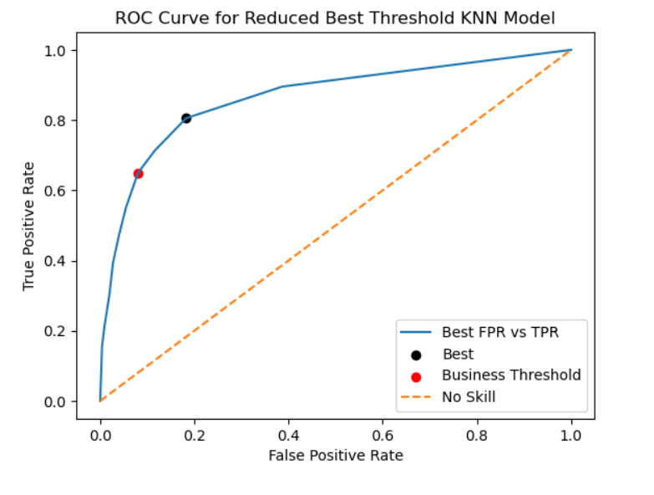
Appendix

Slide 31
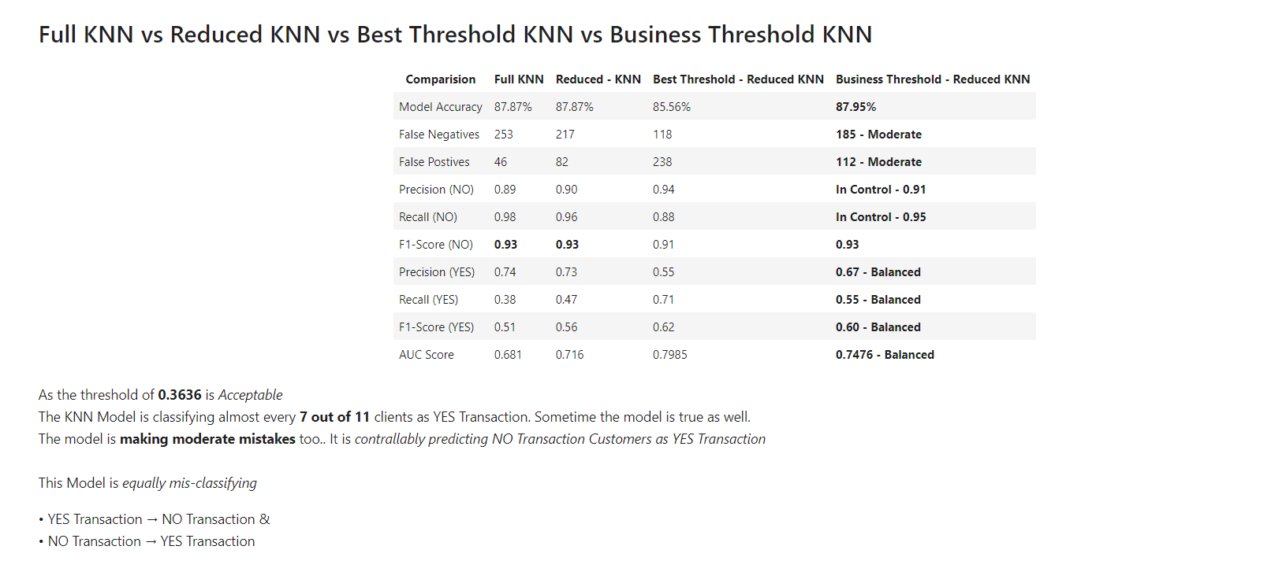
Appendix

Slide 32
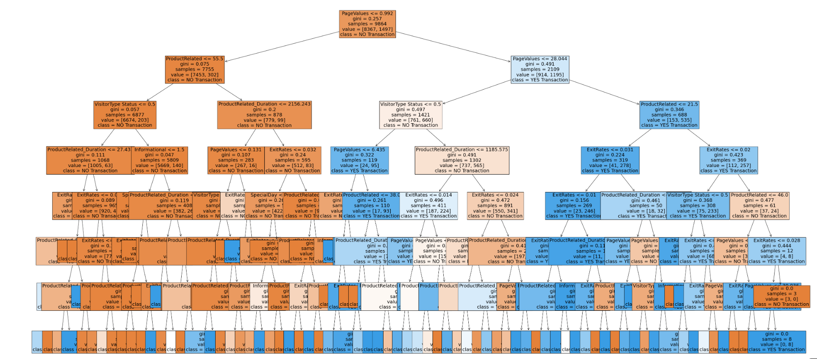
Appendix

Slide 33
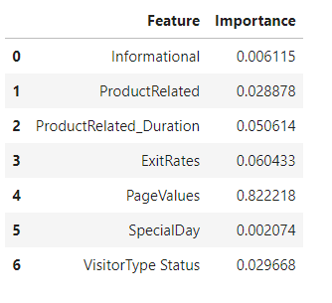
Appendix

Slide 34
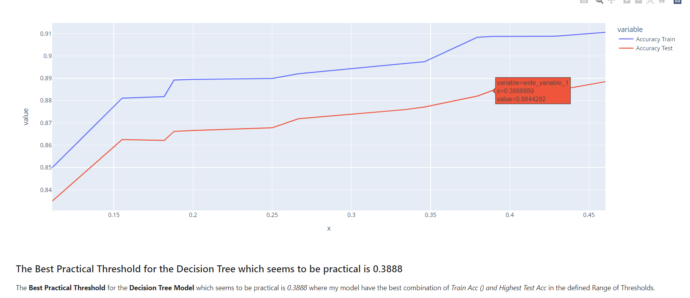
Appendix

Slide 35
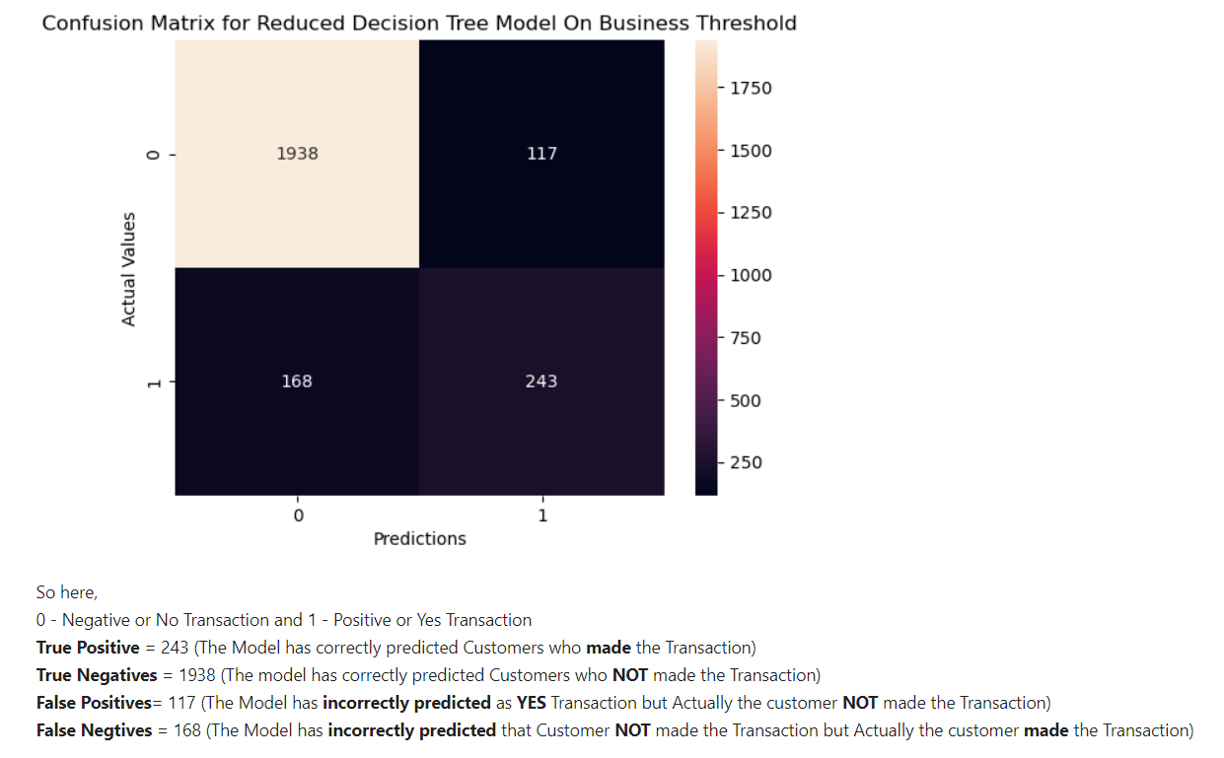
Appendix

Slide 36
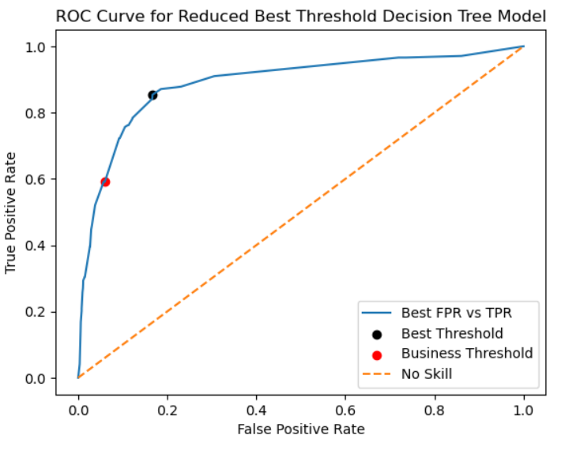
Appendix

Slide 37
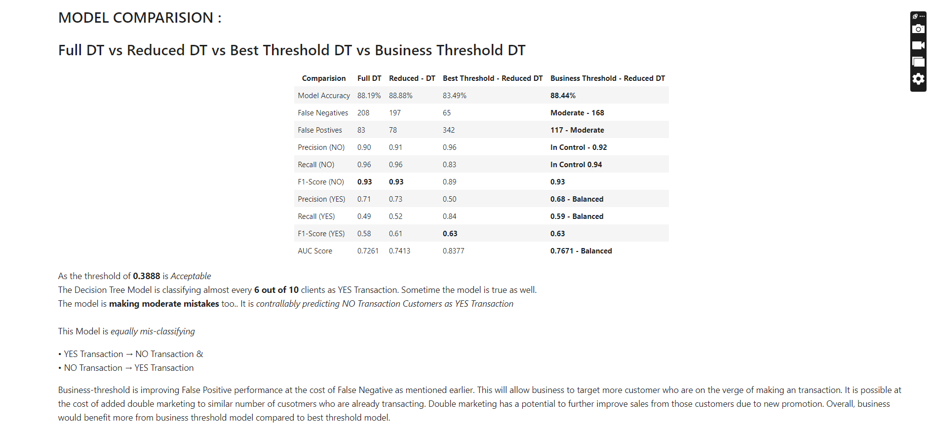
Appendix

Slide 38
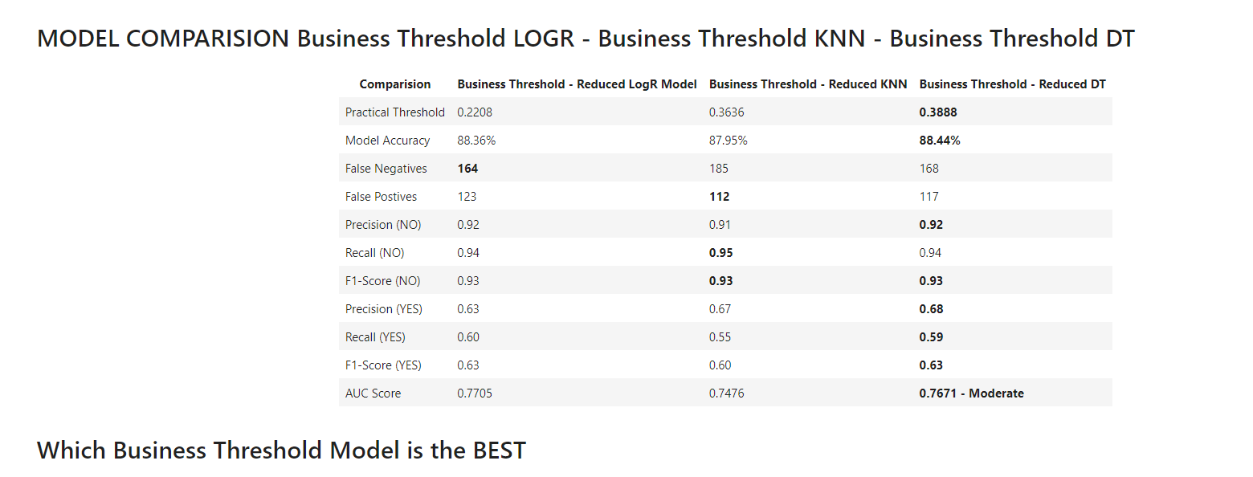
Appendix

Slide 39
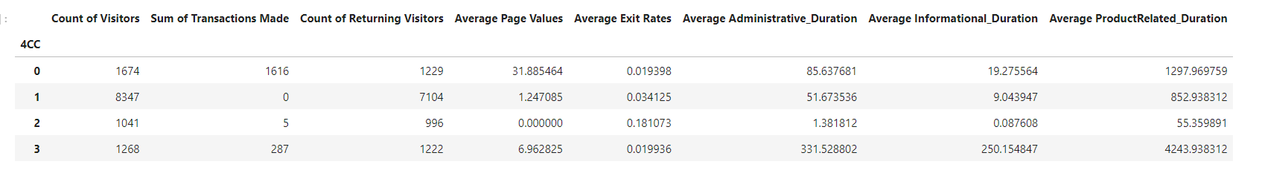
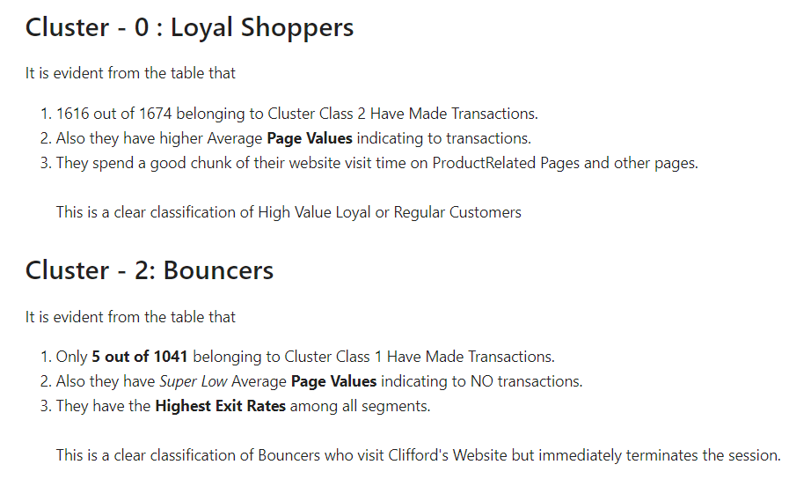
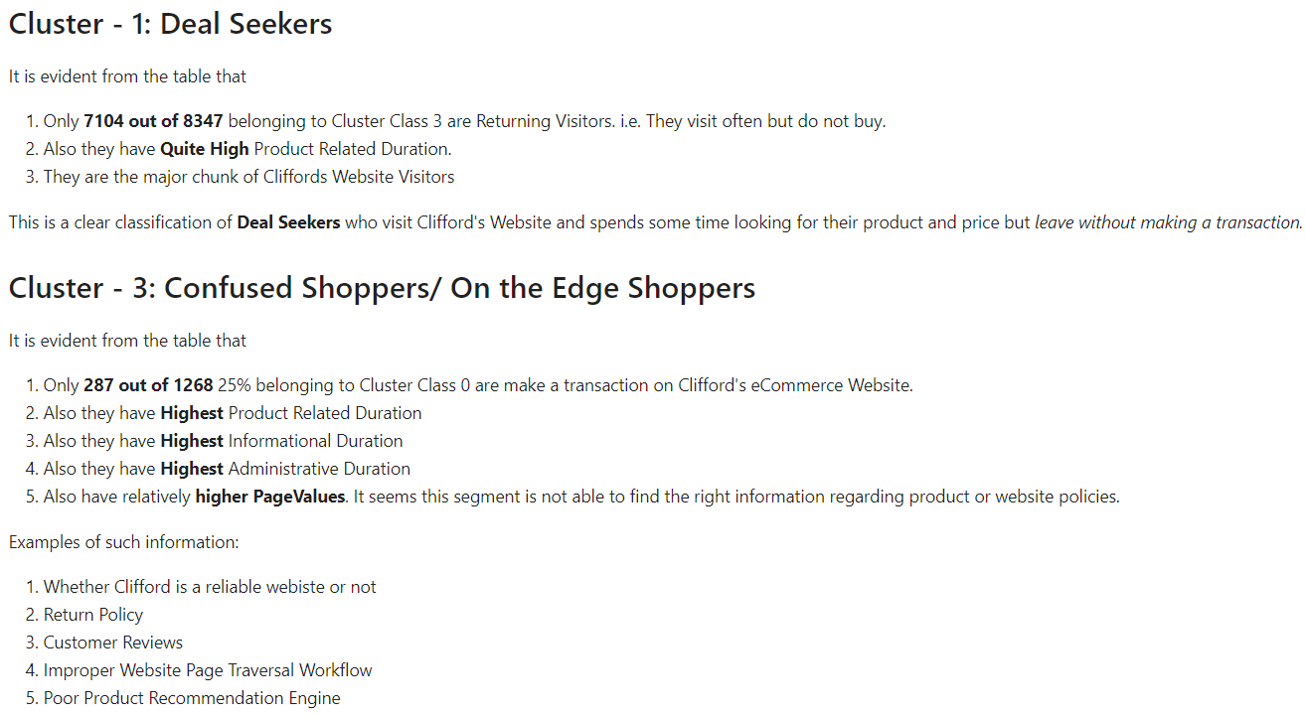
Appendix

